Slide 1
Traffic Signal: Management & Control System
Presented By :
[Student’s Name Here]
[Student’s Name Here]

Slide 2
INDEX
Project Overview
Scope
Modules
Development Tools
Pros & Cons
Applications

Slide 3
PROJECT OVERVIEW
This innovative software project is an effective traffic signal management project that allows for managing 4 way traffic signal management system. The system consists of 4 signals corresponding to each road. We here propose a density based traffic signal scheduling algorithm. The system is designed to manage traffic signal timings based on the density of traffic on its corresponding road. The system represents the traffic strength of a road graphically using traffic judgments. By measuring the traffic lined up on a particular road the signal timings are adjusted to let that particular way clear out and then the next populated one. The entire system works according to an algorithm that allows for smooth and efficient traffic flow across all four ways. It also consists of an emergency override that allows traffic authorities to remotely let go a particular signal in case an ambulance or important vehicle arrives on that way.

Slide 4
MODULES
ADMIN
  Login
  Set Interval
  Manage Traffic

Slide 5

DEVELOPMENT TOOLS
MICROSOFT VISUAL STUDIO
Microsoft Visual Studio is an integrated development environment (IDE) from Microsoft. It is used to develop computer programs, as well as websites, web apps, web services and mobile apps. Visual Studio supports 36 different programming languages and allows the code editor and debugger to support nearly any programming language.
Features:
1. Code Editor 2. Debugger 3. Designer 4. Extensibility

Slide 6
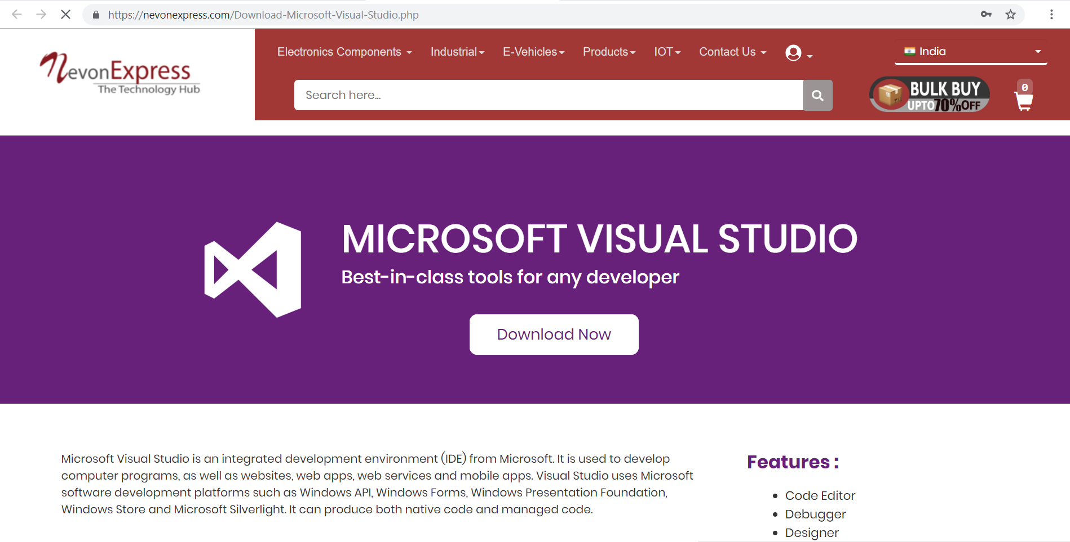
DOWNLOAD MS VISUAL STUDIO
We can get Visual Studio from NevonExpress.com : Visit Here

Slide 7

DEVELOPMENT TOOLS
MICROSOFT SQL SERVER
Microsoft SQL Server is a relational database management system developed by Microsoft. As a database server, it is a software product with the primary function of storing and retrieving data as requested by other. Microsoft markets at least a dozen different editions of Microsoft SQL Server, aimed at different audiences and for workloads.
Features:
1. Least Vulnerable 2. Advanced Analytics 3. Easy-to-Use

Slide 8
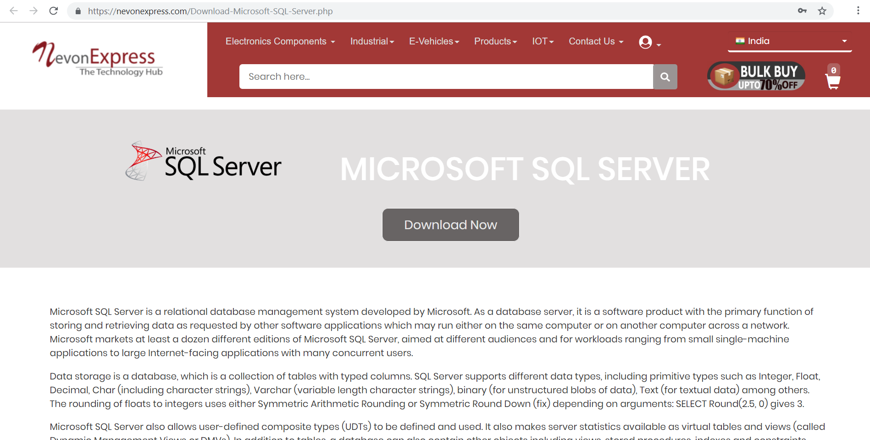
DOWNLOAD MICROSOFT SQL SERVER
We can get SQL Server from NevonExpress.com : Visit Here

Slide 9
PROS & CONS
Advantages
System can enhance traffic signal performance.
System reduces traffic jams.
Disadvantages
System will not able to control traffic rule breakers

Slide 10
APPLICATIONS
The system is proposed to be used in road traffic signals.
Can be enhanced to be used for 5 way and 8 way road junctions.

Slide 11
THANK YOU !!!

